Slide 1
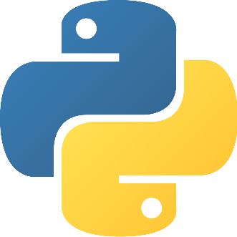
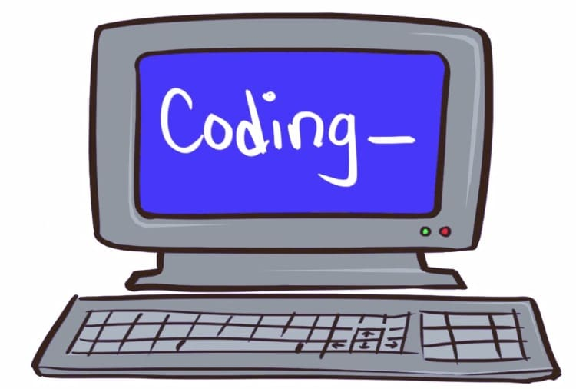
Python workshop

Slide 2
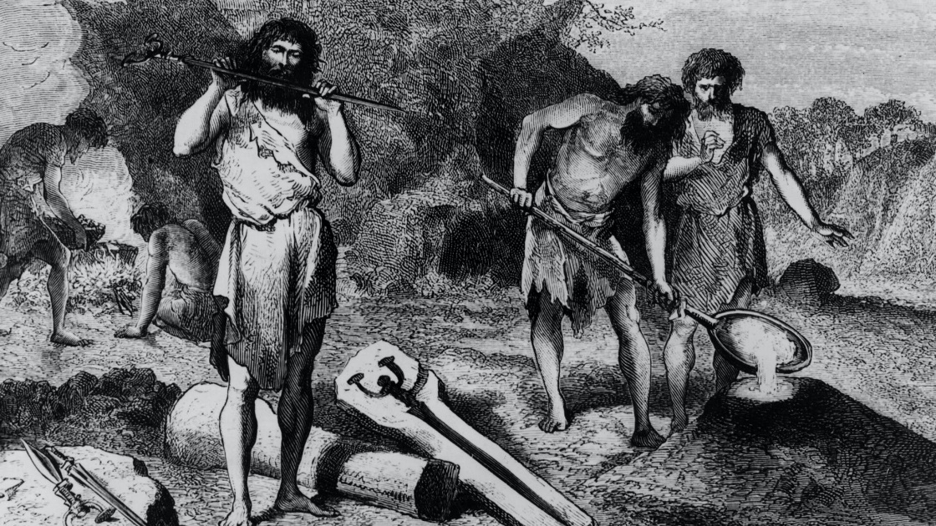
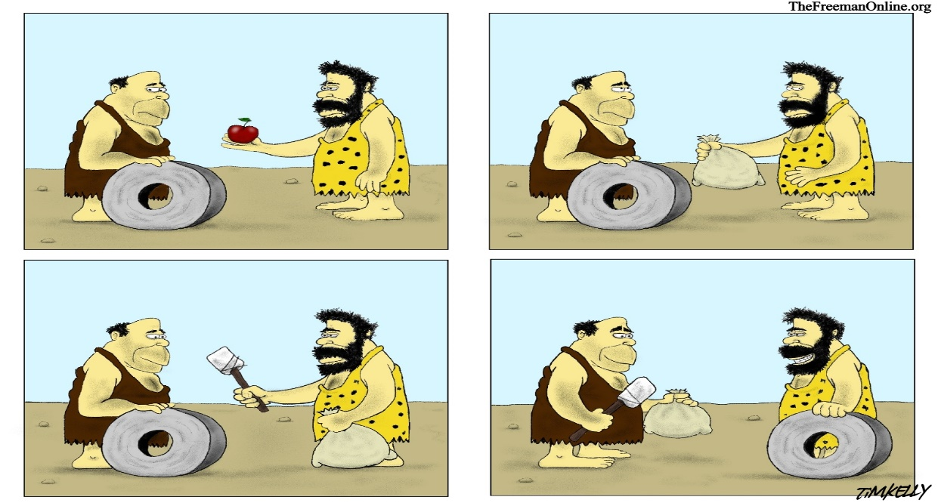
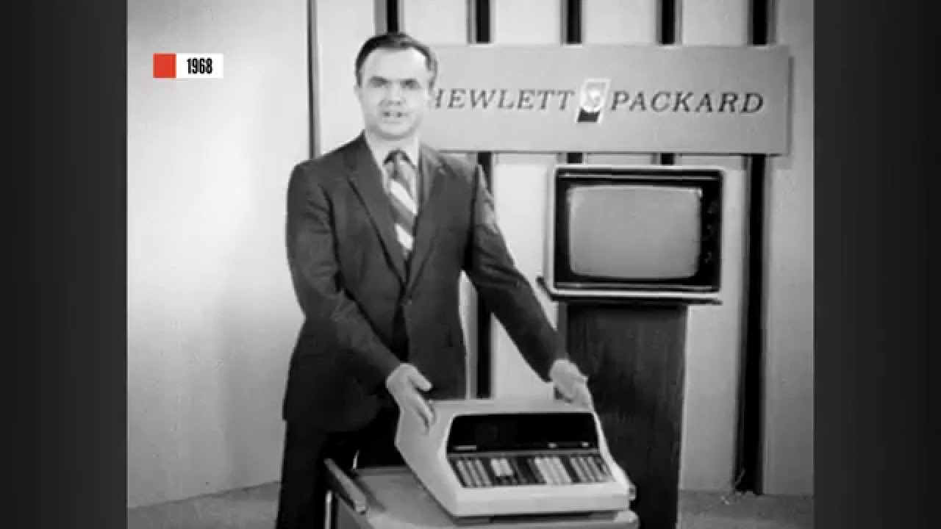
(1)
(2)
(3)
(4)

Slide 3
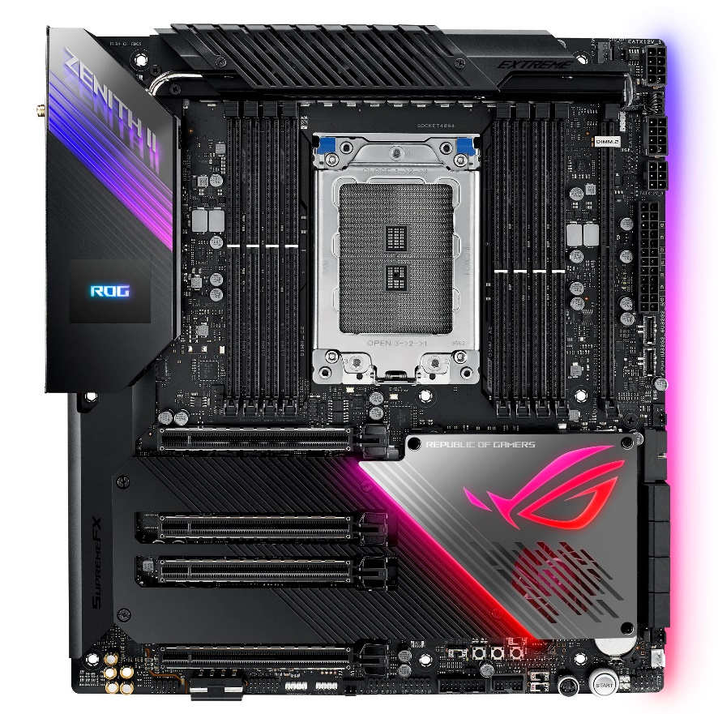
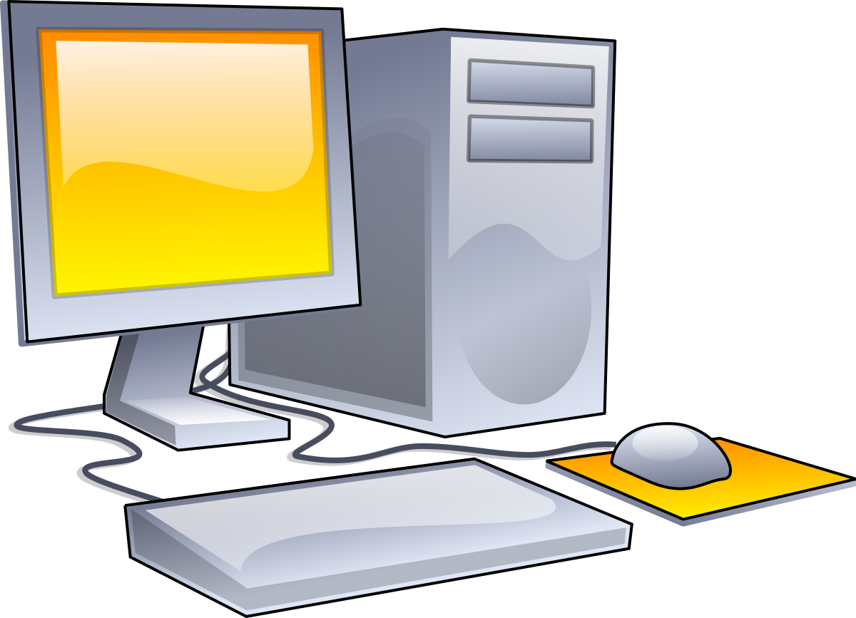
(2)
(1)

Slide 4
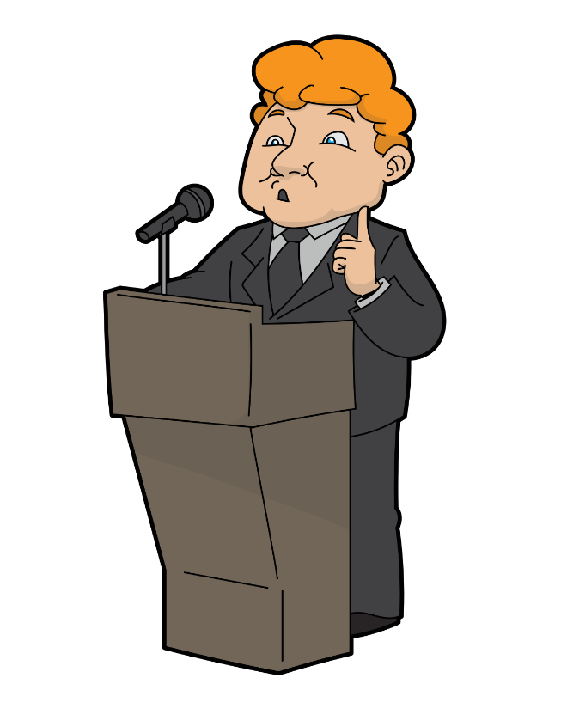
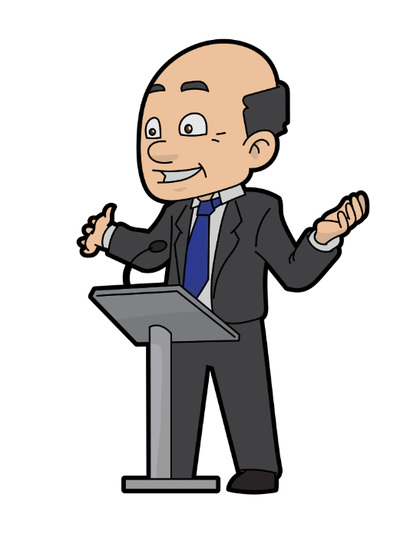
WHAT IS PROGRAMMING LANGUAGE??
A programming language is a formal language comprising a set of instructions that produce various kinds of output.
Programming languages are used in computer programming to implement algorithms.
This Photo by Unknown Author is licensed under CC BY-SA
This Photo by Unknown Author is licensed under CC BY-SA

Slide 5
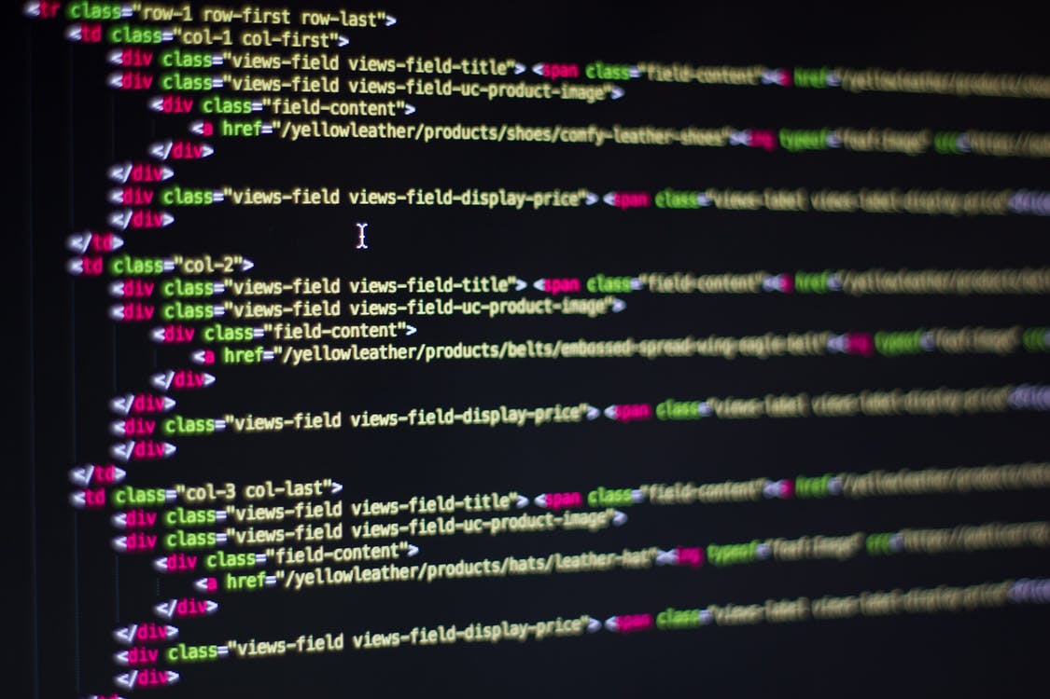
Different types of Programming languages
C++ language
C language
C#
Java
JavaScript
Python
and many more........

Slide 6
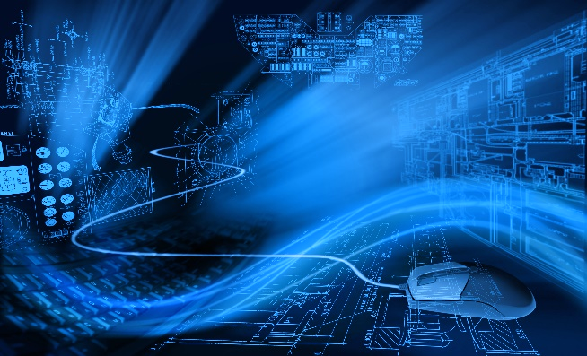
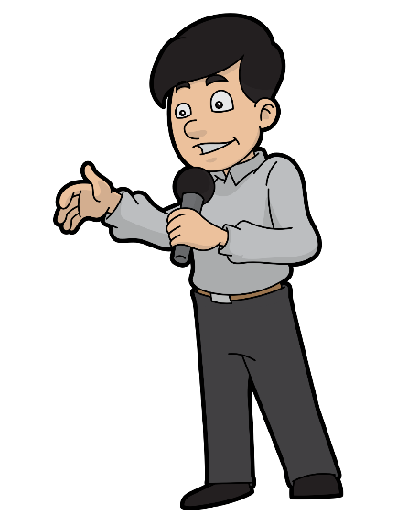
WHAT IS python??
Python is an interpreted, high-level and general-purpose programming language.
Python's design philosophy emphasizes code readability with its notable use of significant whitespace.
Its language constructs and object-oriented approach aim to help programmers write clear, logical code for small and large-scale projects.

Slide 7

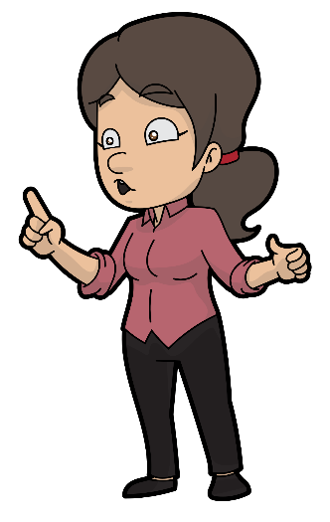
Why is it called Python? ...
Guido van Rossum was the inventor of python language .
When he began implementing Python, Guido van Rossum was also reading the published scripts from “Monty Python's Flying Circus”, a BBC comedy series from the 1970s.
Van Rossum thought he needed a name that was short, unique, and slightly mysterious, so he decided to call the language Python.
This Photo by Unknown Author is licensed under CC BY-SA

Slide 8
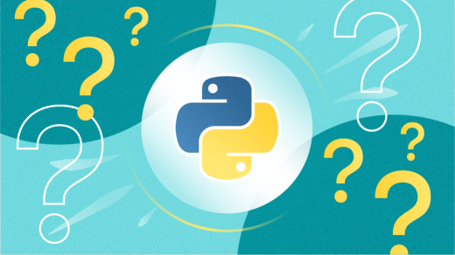
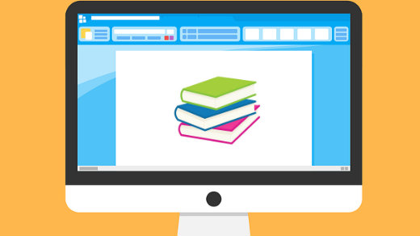
Why to learn python?
Python is highly flexible and extensible.
Python has a library to cater to your every need.
Python makes web development a breeze.
There's plenty for Data Visualization.
Python comes with numerous testing frameworks.
Python is excellent for Enterprise Application Integration (EAI)
Python is great for scripting.

Slide 9
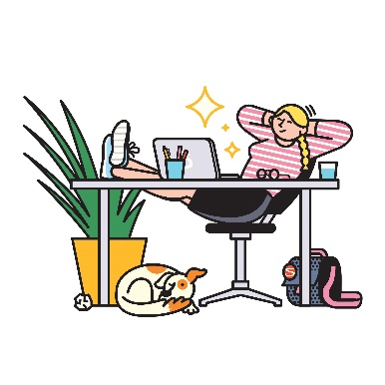
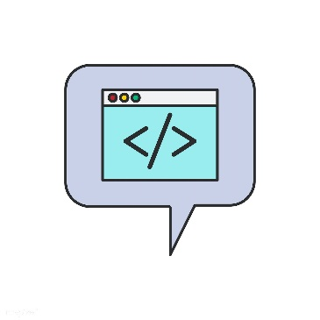


Applications
Web Development.
Game Development.
Scientific and Numeric Applications.
Artificial Intelligence and Machine Learning.
Software Development.
Enterprise-level/Business Applications.
Education programs and training courses.
Language Development.
This Photo by Unknown Author is licensed under CC BY
This Photo by Unknown Author is licensed under CC BY

